Slide 1

Automation of Weather-Based Sales and Staffing Decisions
Japheth Gordon
AI Automation | Project 5

Slide 2
Automated Staff Decisions Zapier
Problem: Manual kiosk management fails Miami's 24M tourists—weather changes too fast, 150+ devices can't be updated manually, and coastal conditions require automated monitoring.
Daily Schedule trigger runs at 7 AM Miami time
OpenWeatherMap webhook pulls real-time forecast data (temp, rain, UV, wind)
Google AI Studio (Gemini) analyzes data to generate:
Top products to promote on kiosks
Staff preparation suggestions
Two short tourist-focused promo messages
Results push to kiosks via MDM for immediate display
Example: "85°F + 60% rain → Promote ponchos/sunscreen, staff preps indoor maps, 'Rainy beach day? Ocean Drive dining awaits!'"
Perfect for Miami—auto-adapts kiosk content to coastal weather patterns serving tourists reliably.

Slide 3
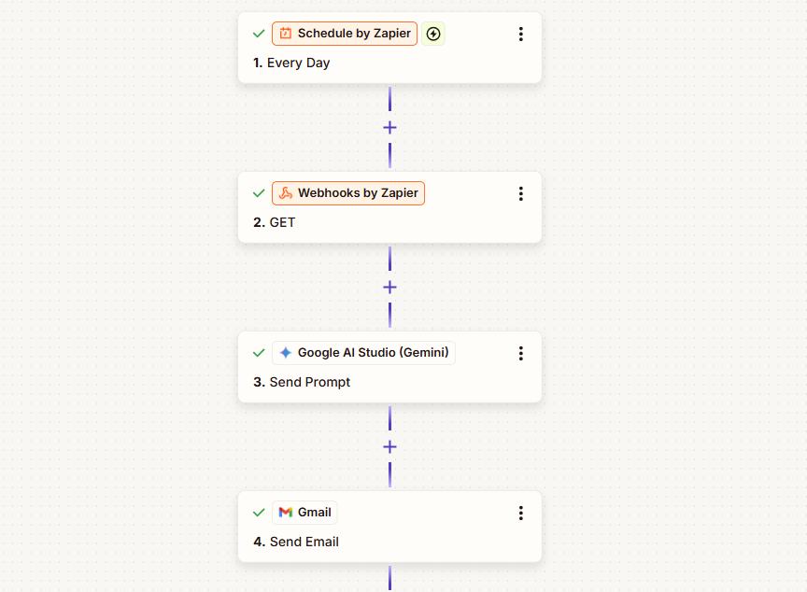
Zapier Workflow
Miami Kiosk Weather Zap (Daily 6 AM):
Schedule → Triggers daily
OpenWeatherMap → Grabs Miami forecast (temp, rain, UV, wind)
Google AI (Gemini) → Generates: 2 products to promote, 1 staff action, 2 promo messages
MDM Push → Updates kiosk displays directly
Example: "85°F + rain → Ponchos/sunscreen, stock indoor maps, 'Rainy day? Ocean Drive dining!'"
Streamlined for Miami kiosks—auto-adapts content to coastal weather for tourists.

Slide 4
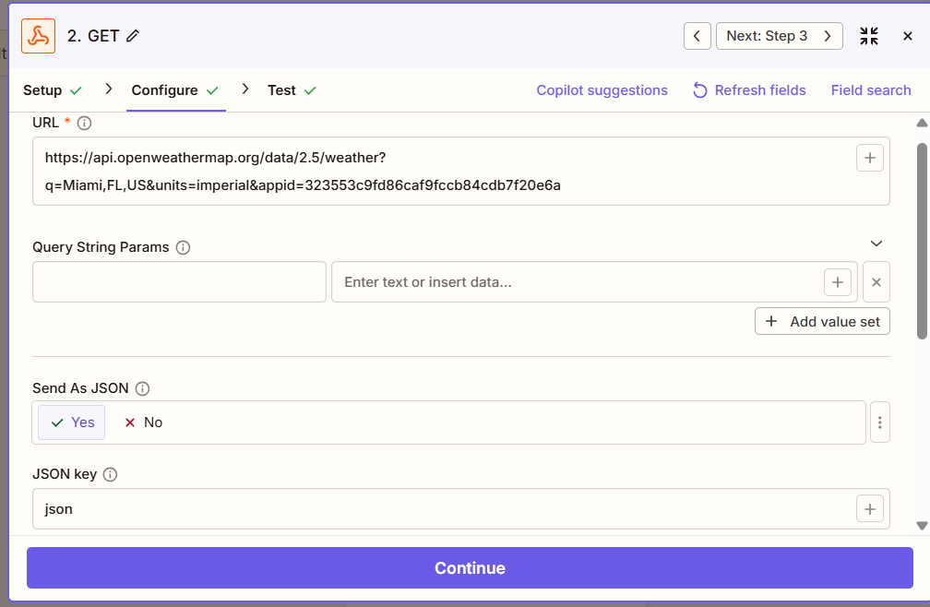
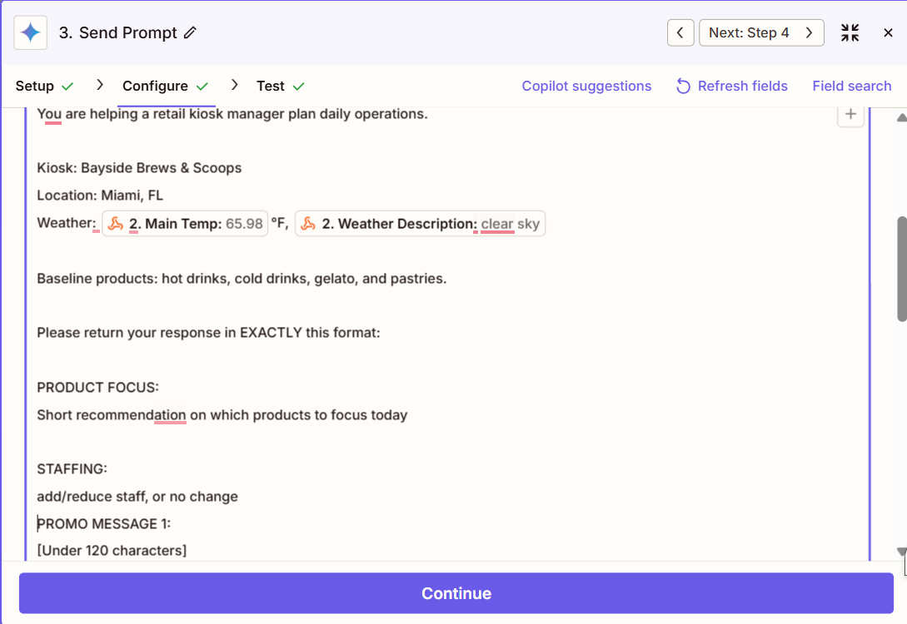
Input > Output > Process
Input: API pulls temp, rain, UV, wind for Miami
Process: Gemini prompt analyzes → recommends products/staff/promos
Output: "85°F + rain → Ponchos, indoor maps, 2 promo messages" → kiosks

Slide 5
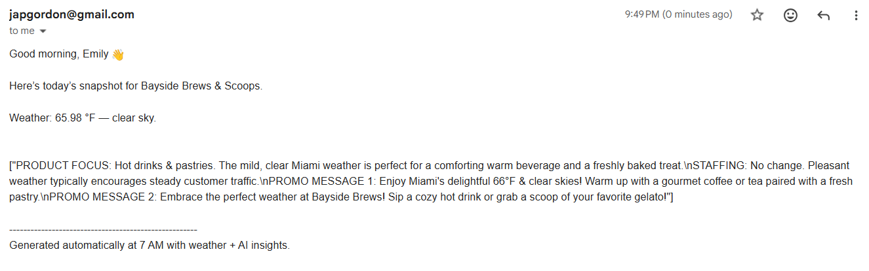
Final Output Processed
The final email (or MDM update) summarizes the Zap’s daily run: Gemini outputs product suggestions, staff prompts, and two short promos for that day’s Miami weather, which are then pushed directly to kiosks for tourists.

Slide 6
Future Improvements
Enhanced Reliability
Add error-handling for API failures with fallback data or Slack alerts
Implement real-time weather triggers for urgent updates (hurricanes, severe storms)
Better User Experience
Rich HTML emails with visual previews and QR codes for kiosk testing
Dashboard analytics (Airtable/Google Sheets) to track promo performance and trends
Advanced Functionality
Migrate to Make.com or n8n for multi-day forecasts and A/B promo testing
Fine-tune Gemini with Miami event calendars (Art Basel, festivals) for hyper-local relevance
Add ROI tracking via Google Analytics to measure kiosk engagement and conversion

